Slide 1
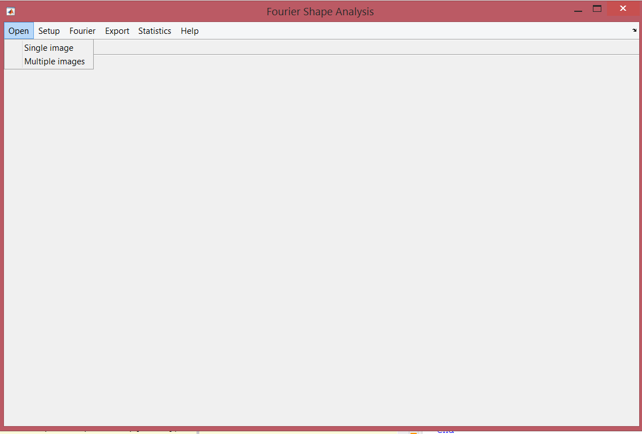
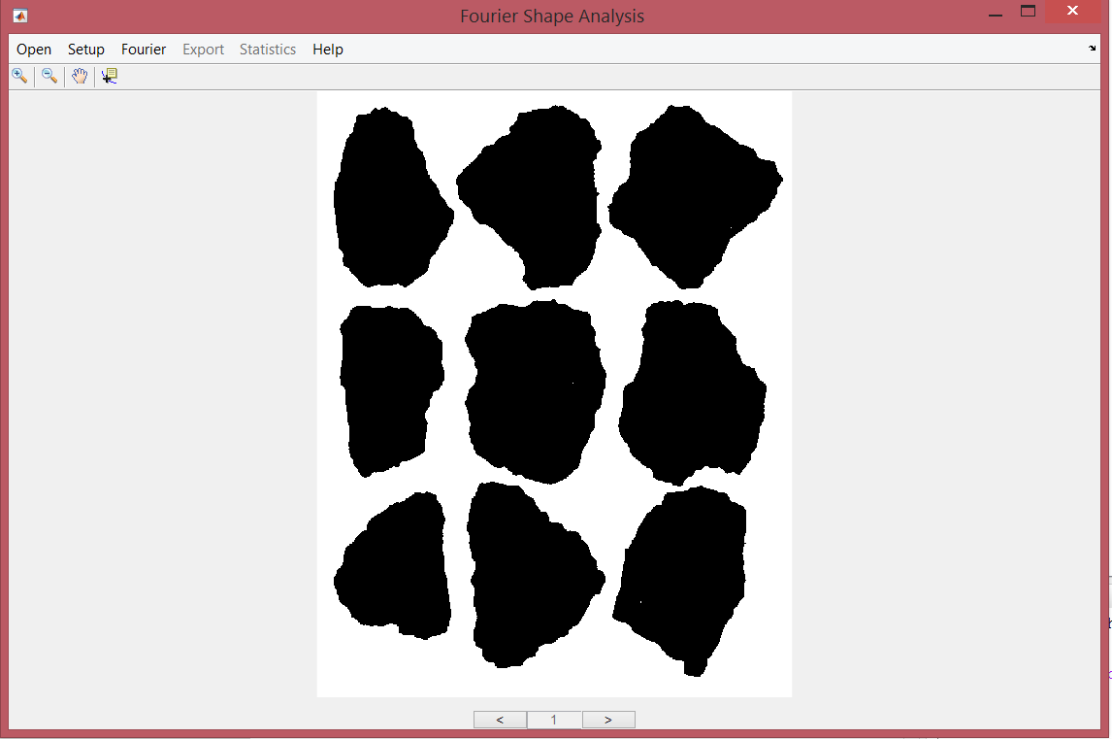
OPEN MENU
A segmented image is necessary to use this software.
Click in the open menu to select single image to defining the address path and selecting the image.
Select multiples images to analyze a complete folder. If multiples images where selected, a navigator can be used to observe every image.
After selecting the image to analyze is shown on the screen.
The user can be used the digital zoom to enlarge or reduce the size of the image, the user can use the pan tool to relocate the image in the window.
Zoom and pan tools
Image navegator

Slide 2
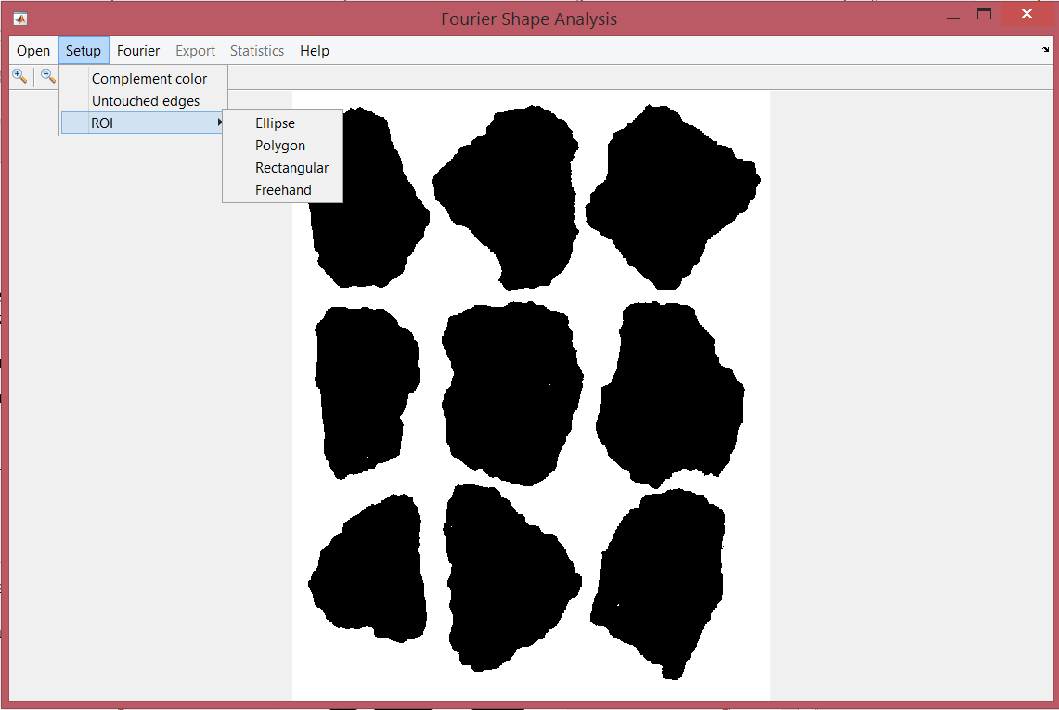
SETUP MENU
The software analyzes by default the particles in the white color. To analyze particles in black color, select Complement color in the Setup menu.
Particles that are on the edge and that are not completely observed in the image can be excluded from the analysis selecting Untouched edges in the Setup menu.
An ROI (Region Of Interest) can be employed by the user to analyze a specific region of the image, the user can draw different geometries such as the ellipse, polygon, rectangular and freehand shape. This option is available in the Setup menu.

Slide 3
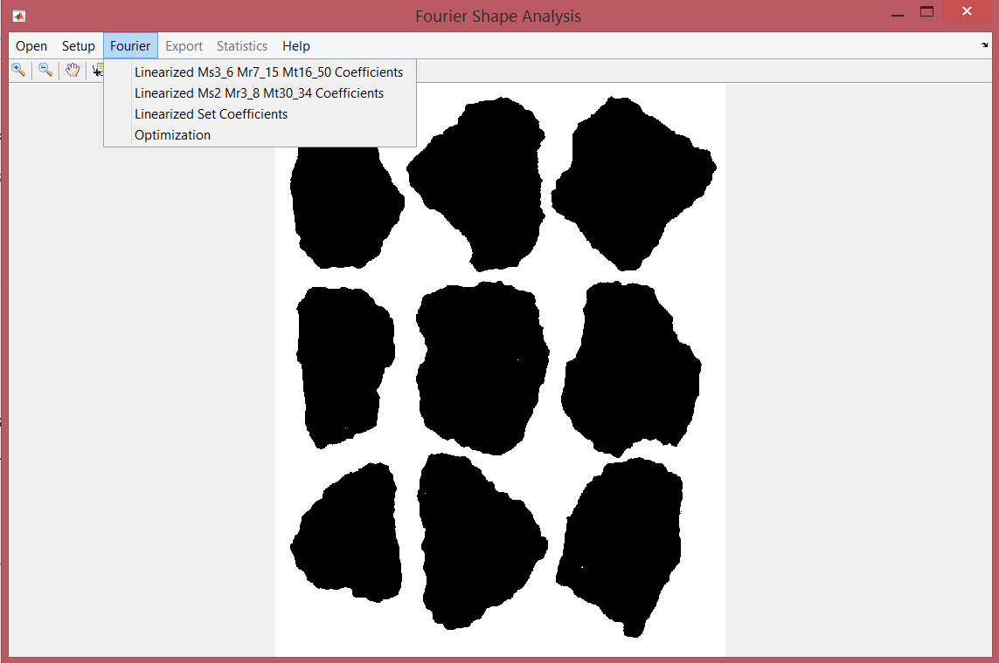
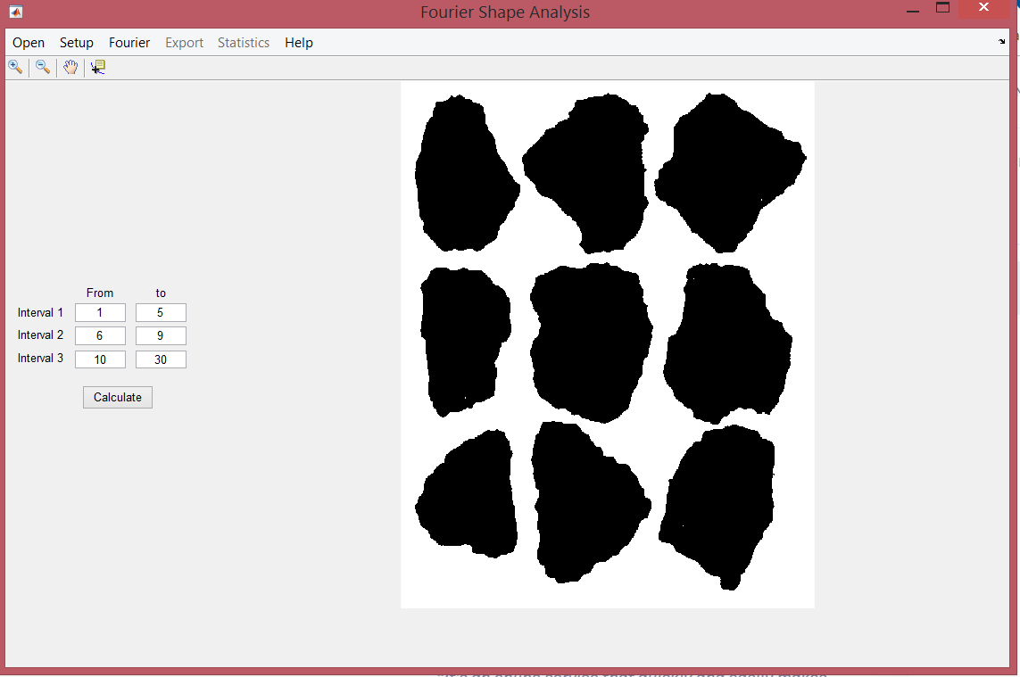
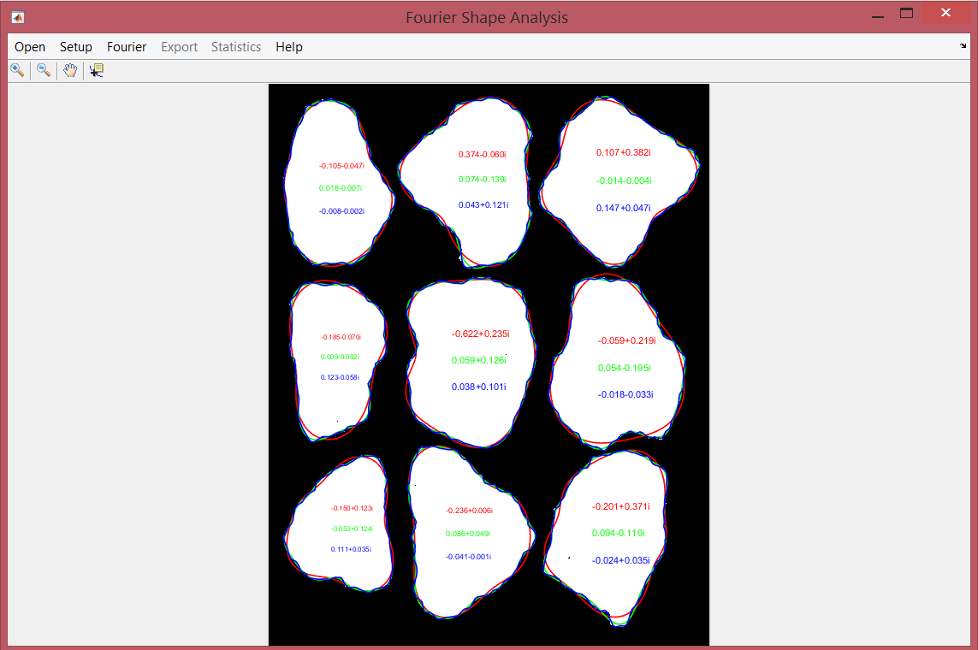
FOURIER MENU
To perform the Fourier analysis:
Select linearized Ms3_7 Mr7_15 Mt16_50 Coefficients. This analysis gives the mean value of the set coefficients (3-7), (7-15), (16-70) of the power spectrum.
Select linearized Ms2 Mr3_8 Mt30_34 Coefficients. This analysis gives the mean value of the set coefficients (2), (3-8), (30-34) of the power spectrum.
Select linearized Set Coefficients to obtain the mean of a set defined by the user. Define the coefficients in the box and push calculate to perform the analysis.
Select Optimization, this function automatically calculates the inflection point that differentiates the general form and the roundness of the particle.
After the analysis is executed, the particles with the average value of the coefficients are shown on the screen and the contour of the particle is drawn using the inverse Fourier transform.

Slide 4
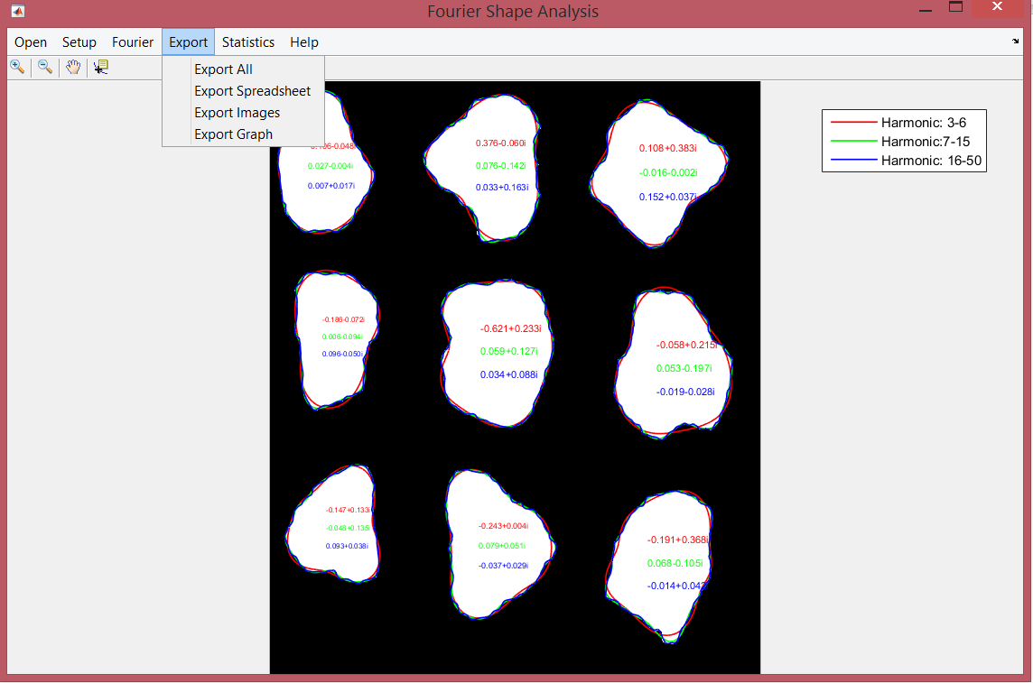
EXPORT MENU
The results can be exported to a spreadsheet. Also, the images and graphs can be exported by selecting the appropriate option in the Export menu.
Selecting Export All; data, images, and graphs can be saved.

Slide 5
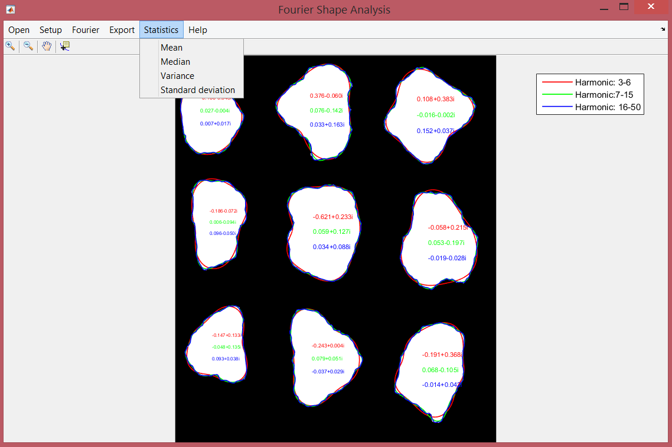
STATISTICS MENU
Calculates the mean, median, variance and the standard deviation of the Fourier spectrum of the total of the particles that were analyzed. The results are exported in a data sheet.

Slide 6
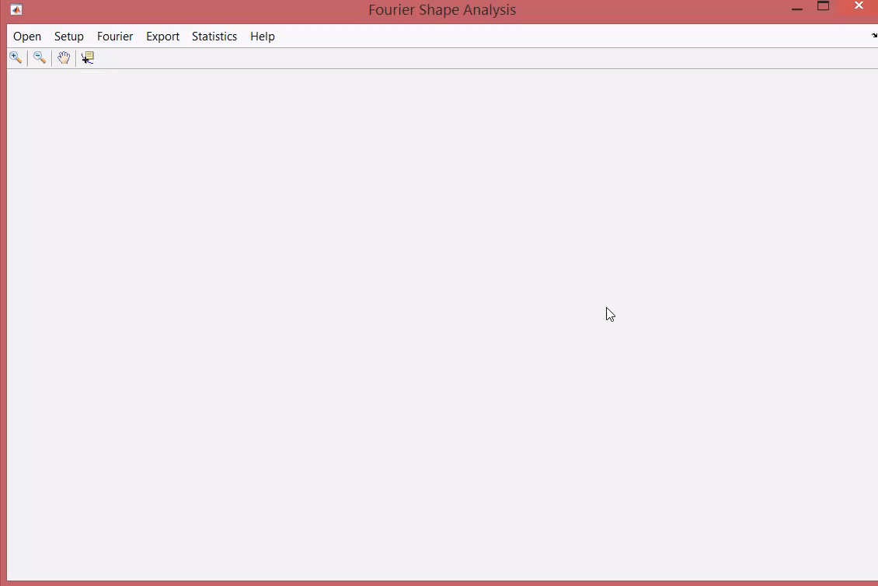
DEMO VIDEO (Single image)

Slide 7
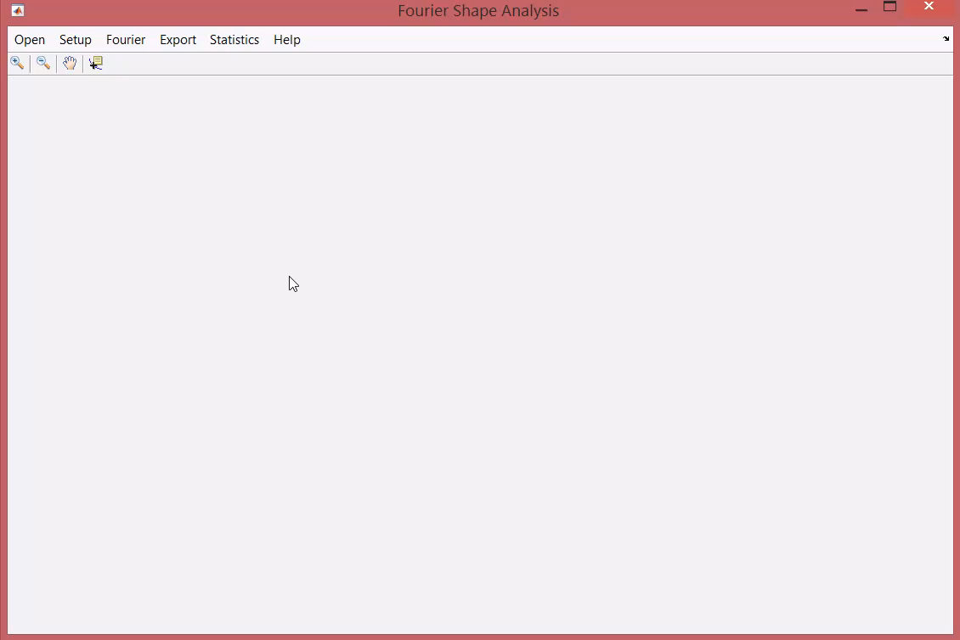
DEMO MILTIPLES IMAGES

